Slide 1
4. Constituent order typology
ENG 452: Linguistic Typology

Slide 2
1.1 Introduction
A prominent area of study within typology deals with the order of elements in clauses and phrases
We have seen few examples of language universals, like
a. Greenberg’s Universal 4: With overwhelmingly greater than chance frequency, languages with
normal SOV order are postpositional.
b. Greenberg’s Universal 3: Languages with dominant VSO order are always prepositional.
In this lecture, we take a closer look at constituent order typology and some possible explanations for them.

Slide 3
One of the primary ways in which languages differ from one another is in the order of constituents,
or, as it is most commonly termed, their word order.
Word order is the linear order of words in a sentence.
Every language follows certain patterns of word order.
Deviations from the pattern result in ungrammatical sentence.
When people refer to the word order of a language, they often are referring specifically,
to the order of subject, object, and verb with respect to each other,
but word order refers more generally to the order of any set of elements,
either at the clause level or within phrases, such as the order of elements within a noun phrase.

Slide 4
When examining the word order of a language, there are two kinds of questions one can ask.
The first question is simply that of what the order of elements is in the language.
The second question is that of how the word order in the language conforms to cross-linguistic universals and tendencies.

Slide 5
Recall that there are six logically possible orders of Subject (S), Verb (V), and Object (O)
And all of them have been claimed to serve as the basic constituent order for at least one language in the world.

Slide 6
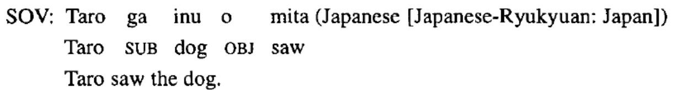
1.2 Some basic word order
1.2.1 Verb-final languages: SOV
We will begin by examining a few of the word order characteristics of verb-final languages, languages in which the verb normally follows the subject and object.
The example in (1) illustrates the verb-final order in Japanese.

Slide 7
Most South Asian Languages are SOV, the verb occurs in the final position of a sentence.
(Except Kashmiri and Khasi)
Modern Tamil
raam raajaa-v-ai ati-tt-aan̠ Lehmann (1993:182)
Ram Raja-ace beat-pst-3sm
S O V
‘Ram beat the Raja.’
Malyalam
śivan̠ ayaaḷe aṭiccu Nair (2012:15)
Sivan he-ACC beat-PAST
S O V
‘Sivan beat him.’

Slide 8
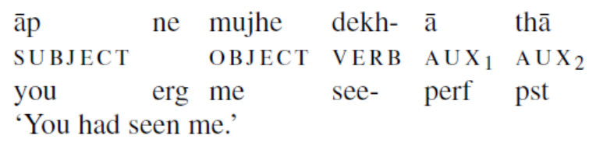
Hindi-Urdu also reflects Subject (S) - Object (O) - Verb (V) word order is.
Hindi-Urdu (IA)
raajiiv kavitaa likh-egaa
rajiv poem write-FUT
‘Rajiv will write a poem.’ (Kumar, 2006)
(Subbarao, 2012)

Slide 9
SOV languages are the most widespread word order type among the languages of the world.
As in all ‘well-behaved’ verb-final languages, in SALs the auxiliary verb follows the main verb.
In most cases, the indirect object precedes the direct object (eg. Hindi).
raajiiv-ne sariitaa ko kapRe di-ye
rajiv-ERG sarita to cloths give-PERF
‘Rajiv gave cloths to Sarita.’ (Kumar, 2006)

Slide 10
Consider the following sentences in Hindi.
ravi-ne sariitaa ko kapRe di-ye (S IO DO V)
ravi-ERG sarita to clothes give-PERF
sariitaa ko ravi-ne kapRe di-ye (IO S DO V)
sarita to ravi-ERG clothes give-PERF
ravi-ne kapRe di-ye sariitaa ko (S DO V IO)
ravi-ERG clothes give-PERF sarita to
kapRe di-ye ravi-ne sariitaa ko (DO V S IO)
clothes give.PERF ravi-ERG sarita to
kapRe di-ye sariitaa ko ravi-ne (DO V IO S)
clothes give.PERF sarita to ravi-ERG
‘Ravi gave clothes to Sarita.’ (Kumar, 2006)

Slide 11
Hindi sentences can, in addition to main verbs, have auxiliary verbs.
These are forms of the verb honaa ‘be.’
It is worth mentioning here that auxiliaries are marked only for present and past tense in Hindi.
They also carry agreement information in both present and past tenses, but gender information appears in past tense alone.
Auxiliaries follow the main verb in Hindi,

Slide 12
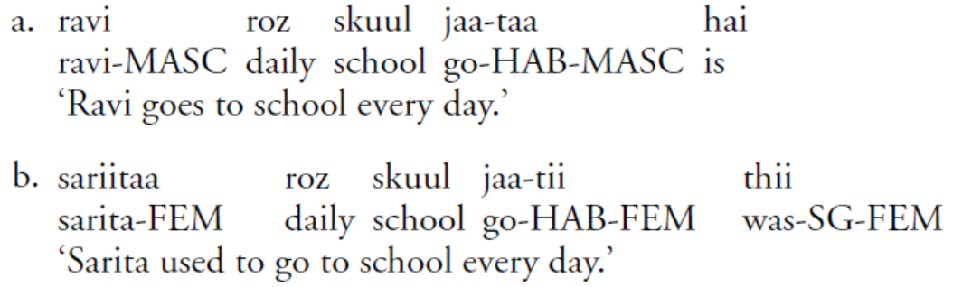
Auxiliaries follow the main verb in Hindi
The sentence in a has an auxiliary verb, hai ‘is,’ in addition to the main verb, jaanaa ‘to go.’
The aux carries agreement features, namely Tense (Present in this case) and number (singular).
On the other hand, the sentence in (b) has an aux, thii ‘was’; it carries the agreement features of the Past Tense, singular number and feminine gender.
(Kumar, 2006)

Slide 13
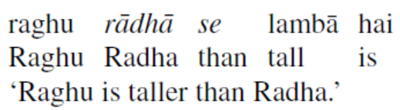
Most SALs (except some Tibeto-Burman languages) lack bound comparative and superlative morphemes, comparable to the -er and -est of English.
As expected, in a verb-final language such as Hindi, the marker of comparison se ‘than’ follows the standard of comparison rādhā ‘Radha’.
(Subbarao, 2012)

Slide 14
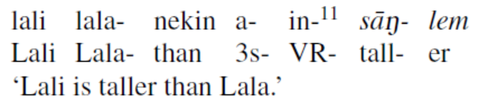
Some Tibeto-Burman languages such as Tenyidie, Bodo, Hmar, Mising and Sema, and the Mon-Khmer Khasi do have bound markers for comparison that correspond to the bound forms –er and –est in English.
For example, in Hmar (TB) in-sāŋ is ‗tall‘, in- sāŋ-lem is ‘tall-er‘ and in-sāŋ-tak is ‗tall-est‘ as in sentence.
(Subbarao, 2012)

Slide 15
Postpositions
In verb-final languages there are only postpositions (except in Persian) and while verb-medial languages such as English have prepositions.
Hindi-Urdu (IA)
kamre ke andar
room of inside
“inside the room”
Telugu (DR)
gadi loopala
‘room inside’
‘inside the room’
Greenberg’s UNIVERSAL 4:
With overwhelmingly greater than chance frequency, languages
with normal SOV order are postpositional.

Slide 16
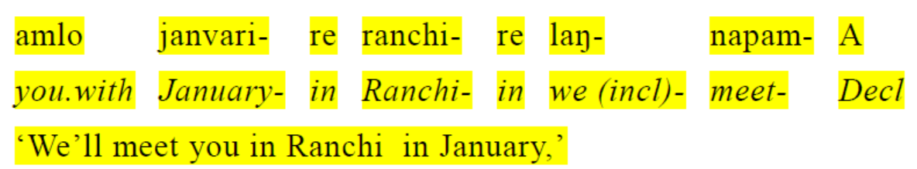
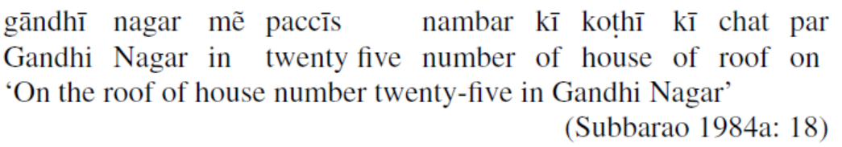
Time adverbials (T) precede place adverbials (P) in SOV languages. Thus, the order of their occurrence is TP.
Time adverbials
Mundari (AA)
Time and place adverbials occur in descending order in verb-final languages (Subbarao 1984a). By descending order, we mean the superordinate chunk of place or time occurs first, then a subordinate chunk, and then a chunk subordinate to that follows.
Place adverbials
Hindi-Urdu (IA)

Slide 17
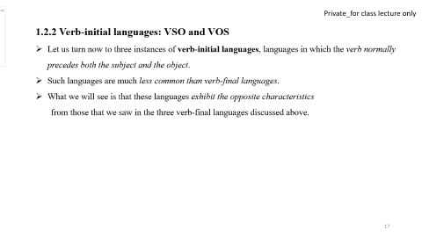
1.2.2 Verb-initial languages: VSO and VOS
Let us turn now to three instances of verb-initial languages, languages in which the verb normally precedes both the subject and the object.
Such languages are much less common than verb-final languages.
What we will see is that these languages exhibit the opposite characteristics
from those that we saw in the three verb-final languages discussed above.

Slide 18
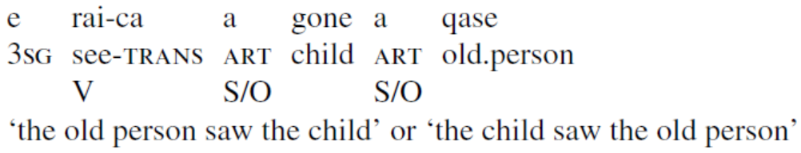
The first verb-initial language we will look at is Fijian, an Austronesian language spoken on the island of Fiji in the Pacific Ocean (Dixon (1988)).
Both the subject and the object follow the verb in Fijian, though they can occur in either order with respect to each other.

Slide 19
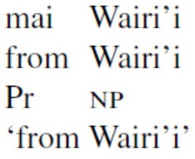
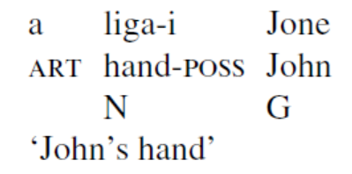
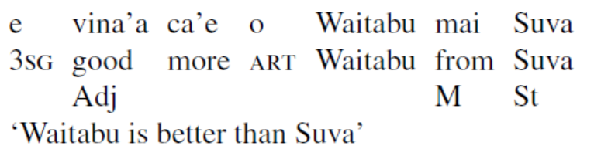
The language employs prepositions (Pr) rather than postpositions:
The genitive follows the possessed noun, rather than preceding.
Note that the possessed noun liga ‘hand’ bears a suffix -i indicating that it is possessed by someone.
The order in comparative constructions is adjective-marker-standard, the opposite from what we saw in the verb-final languages:
Greenberg’s UNIVERSAL 3:
Languages with dominant VSO order are always prepositional.

Slide 20
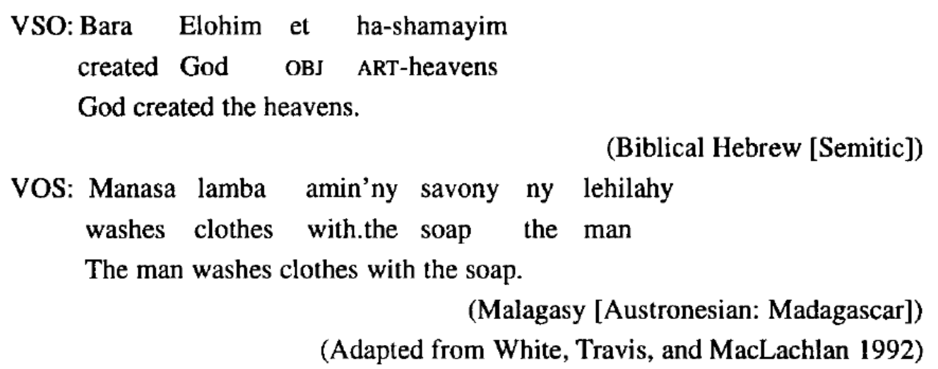
Another Verb-initial languages: (VSO and) VOS

Slide 21
1.2.3 SVO languages
Now consider instances of SVO languages, which are neither verb-final nor verb-initial, since the subject precedes the verb while the object follows the verb.
SVO languages are the second most wide spread word order type among the languages of the world, more common than verb-initial, but less widespread than verb-final languages.
What we will see is that these SVO languages strongly resemble the verb-initial languages rather than the verb-final languages with respect to the word order characteristics examined.

Slide 22
Consider first English, which has SVO word order:
The woman saw the dog
S V O
*Saw the woman the dog
a. John ate an apple.
b. *John an apple ate.
c. *Ate John an apple.
Every language follows certain patterns of word order.
Deviations from the pattern result in ungrammatical sentence.
Notes:
Note that the marker of comparison is the word than, rather than the word
more. Most languages do not employ a word meaning ‘more’ in comparative
constructions, using expressions that literally translate more like ‘Nancy is
intelligent than Jeff’, although the marker of comparison in such languages
might be considered to mean ‘more than’ rather than just ‘than’.

Slide 23
While languages are classified according to word order in this way, there are always exceptions.
The word order in English is fairly strict, but certain contexts can change it.
a. Is Mary a student? (VSO)
b. Oh, apples, I like. (OSV)
Notes:
Note that the marker of comparison is the word than, rather than the word
more. Most languages do not employ a word meaning ‘more’ in comparative
constructions, using expressions that literally translate more like ‘Nancy is
intelligent than Jeff’, although the marker of comparison in such languages
might be considered to mean ‘more than’ rather than just ‘than’.

Slide 24
Word order restrictions go far beyond the relative ordering of verbs, subjects, and objects.
Demonstrative and Prepositions must precede the noun phrase.
a. Mary finally met with that person.
b. * Mary finally met that person with.
a. Mary still hasn’t read these books.
b. * Sally still hasn’t read books these.
But remember: Indo-Aryan, Dravidian, and Tibeto-Burman languages have postpositions that occur after the noun.
Notes:
Note that the marker of comparison is the word than, rather than the word
more. Most languages do not employ a word meaning ‘more’ in comparative
constructions, using expressions that literally translate more like ‘Nancy is
intelligent than Jeff’, although the marker of comparison in such languages
might be considered to mean ‘more than’ rather than just ‘than’.

Slide 25
Now, as in the verb-initial languages we examined, English employs prepositions:
On the table
Prep NP
The order in comparative constructions is Adj-Marker of comparison-Standard of comparison:
Nancy is more intelligent than Jeff
Adj M St
Notes:
Note that the marker of comparison is the word than, rather than the word
more. Most languages do not employ a word meaning ‘more’ in comparative
constructions, using expressions that literally translate more like ‘Nancy is
intelligent than Jeff’, although the marker of comparison in such languages
might be considered to mean ‘more than’ rather than just ‘than’.

Slide 26
Kashmiri (IA) and Khasi (AA) are also SVO word order
Kashmiri (Indo-Aryan language)
rāman dits šāmas kitāb
Ram.erg give.pst Sham.dat book
S V IO DO
‘Ram gave Sham a book.’
Khasi (Austroasiatic language)
nga bam ja
I eat rice
S V O
‘I eat rice.’
Notes:
Note that the marker of comparison is the word than, rather than the word
more. Most languages do not employ a word meaning ‘more’ in comparative
constructions, using expressions that literally translate more like ‘Nancy is
intelligent than Jeff’, although the marker of comparison in such languages
might be considered to mean ‘more than’ rather than just ‘than’.

Slide 27
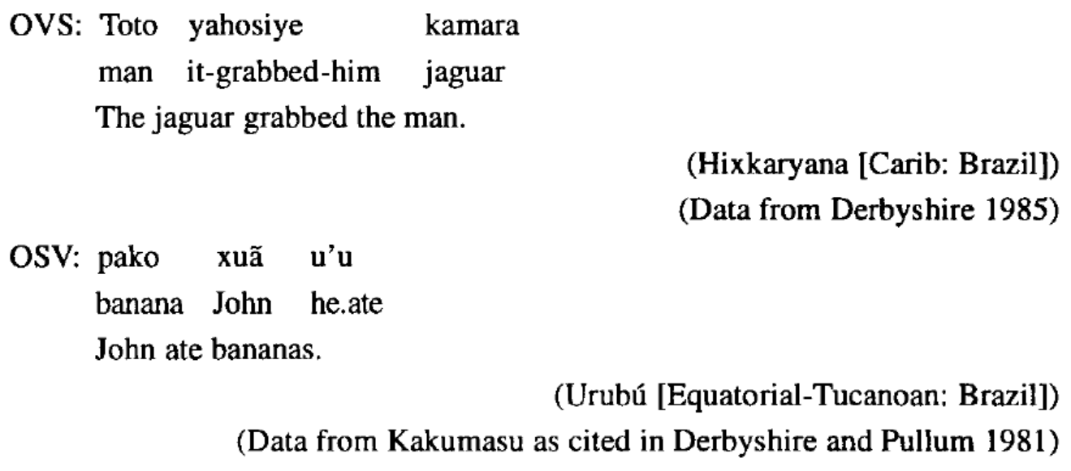
1.2.4 Object-initial languages: OVS and OSV
We had seen the most common word orders, SOV, SVO, and verb-initial languages (which includes both VSO and VOS).
Now, the two remaining orders are OVS and OSV, both quite rare but both claimed to exist.

Slide 28
What word order characteristics are typical of object-initial languages?
Unfortunately, the number of clear cases of such languages is sufficiently small that we cannot really answer this question with any confidence.
The fact that the characteristics in other languages pattern with the order of object and verb would lead us to expect both OVS and OSV languages to pattern with SOV languages.
In so far as we have evidence, this prediction seems to be true.

Slide 29
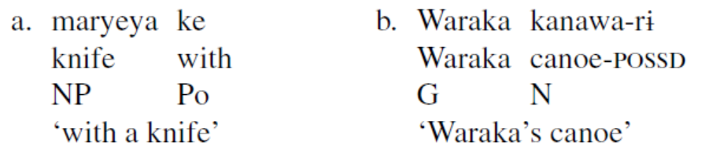
For example, Hixkaryana is postpositional and GN, as illustrated in (35).

Slide 30
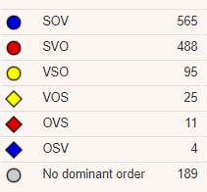
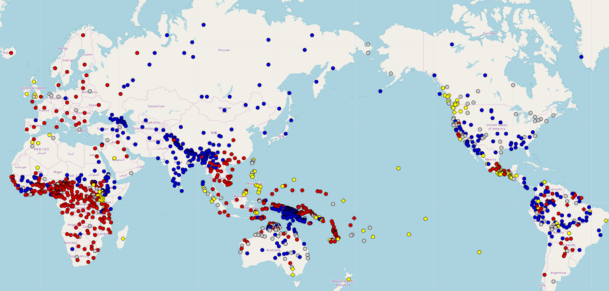
Now mapped: (Dryer 2013; 1377 lgs)

Slide 31
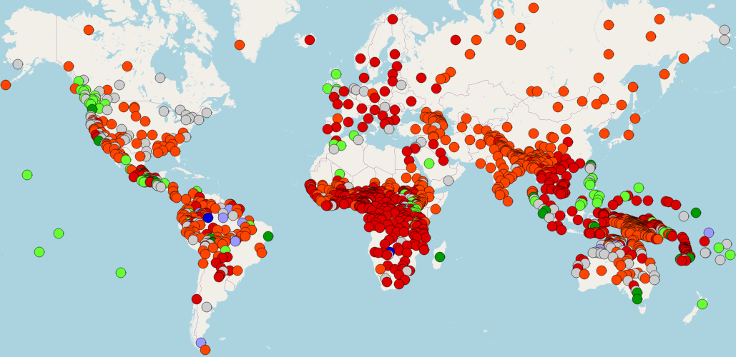
Word Order
Cree (N/A)
English (SVO)
Irish (VSO)
Japanese (SOV)
Nadëb (OSV)
Tuvaluan (OVS)
Malagasy (VOS)
Map adapted from WALS

Slide 32
Frequency of Constituent Orders
The most frequent constituent orders in the world's languages are:
SOV: ~40-45% of languages
SVO: ~35-40% of languages
VSO: ~10-15% of languages
Other orders like VOS, OVS, and OSV are much rarer, making up a small percentage of languages globally.

Slide 33
References
Subbarao, K. V. (2012). South Asian Languages: A Syntactic Typology. Cambridge.
Kumar, R. (2006). Negation and Licensing of Negative Polarity Items in Hindi Syntax. Routledge.
The Syntactic Typology of South Asian Languages: Word Order Universals
https://epgp.inflibnet.ac.in/epgpdata/uploads/epgp_content/linguistics/14._language_universals_and_language_typology_/02._the_syntactic_typology_of__south_asian_languages_word_order_universals/et/8471_et_m2_et.pdf
Linguistic Typology and Language Universals
https://epgp.inflibnet.ac.in/epgpdata/uploads/epgp_content/S000022LS/P001324/M031904/ET/1535433056Lings_P13_M26-eText.pdf

Slide 34
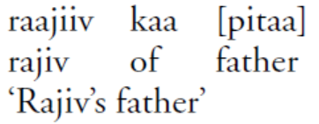
Genitive
Genitives precede the noun in Hindi
and are the head of the Noun phrase
Greenberg’s UNIVERSAL 2
In languages with prepositions, the genitive almost always follows the governing noun,
while in languages with postpositions it almost always precedes.

